Slide 1
Sentiment Analysis on Movie Reviews
By Sarjakkumar Kothiya Abhikumar Patel
SID: U01882769 SID: U01883041

Slide 2
Objective: sentiment analysis on movie reviews to predict sentiments as either positive or negative.
Purpose :
Assess Audience Sentiments: Determine whether movie reviews are positive or negative.
Compare NLP Models: Evaluate various machine learning and deep learning models for sentiment analysis.
Commercial Strategy Tool: Provide insights for film industry marketing and recommendations.
Research and Education: Enhance understanding and application of natural language processing techniques.

Slide 3
Dataset: Metadata available for 50,000 movies in the IMDB Dataset. Movies included were released on or before July 2017. The dataset encompasses various data points such as cast, crew, plot keywords, budget, revenue, posters, release dates, languages, production companies, countries, IMDB vote counts, and vote averages. Dataset contains files with over 10 million ratings. Ratings obtained from 120,000 users. Ratings scale ranges from 1 to 5. Ratings collected from the official IMDB website.

Slide 4
Tools and Libraries Used:
NLTK (Natural Language Toolkit): Used for NLP tasks and It provides tools and methods for text processing, linguistic data analysis, and NLP. NLTK facilitates Text Processing, Tokenization, and Feature Extraction
Naive Bayes Classifier:
Leveraged from Scikit-learn and NLTK libraries for text classification tasks, particularly suited for its simplicity and efficiency in handling large datasets. BERT (Bidirectional Encoder Representations from Transformers):
BERT is utilized to encode movie reviews, converting them into contextualized numerical representations.
These encoded representations are used to train a sentiment analysis model, leveraging BERT's pre-trained features to understand and classify sentiment in movie reviews effectively.

Slide 5
Data Preprocessing
Data preprocessing in text analysis ensures cleaner data, enhances model accuracy, and aids effective handling of text-based datasets.
Conversion to Lowercase:
Convert text to lowercase for uniformity and ease of analysis.
HTML Tag Removal:
Eliminate HTML tags to clean text data for accurate sentiment analysis.
Label Encoding:
Convert sentiment labels ('positive'/'negative') to binary values (1/0) for classification purposes.

Slide 6
Traditional Machine Learning Approach
Mainly we used the Naive Bayes classifier and TF-IDF text vectorization technique as Traditional Machine Learning Approach in our project.
1. Naive Bayes Classifier :
Algorithm Type: Multinomial Naive Bayes used for sentiment analysis.
Simplicity & Effectiveness: Chosen due to its simplicity and robust performance in text classification tasks.
Independence Assumption: Relies on the assumption of independence between features (words) in the text data.
Suitability: Particularly suitable for processing high-dimensional datasets like text due to its efficiency.

Slide 7
2. TF-IDF (Term Frequency-Inverse Document Frequency) Vectorization : This technique we used to transform textual data into numerical vectors.
Term Frequency (TF):
Measures the frequency of a word in a document.
Higher for more occurrences within a document.
Inverse Document Frequency (IDF):
Emphasizes rare words by reducing the weight of common ones across all documents.
Implementation Steps:
Initialized with 5000 maximum features.
Converts text data into TF-IDF weighted numerical vectors.
Importance:
Captures word importance based on occurrence across the entire dataset.

Slide 8
NLTK Sentiment Analysis
NLTK Implementation: Utilized NLTK (Natural Language Toolkit) for sentiment analysis on the movie reviews corpus.
Feature Extraction: Extracted features using word frequencies and selected the top 2000 common words.
Naive Bayes Classifier: Trained a Naive Bayes classifier on the extracted features.
Accuracy Evaluation: Achieved an accuracy score of [insert accuracy] on the test set.
Classification Report: Displayed precision, recall, and F1-score in the classification report for 'Negative' and 'Positive' sentiments.
Visualization: Visualized the NLTK classification report to illustrate model performance.

Slide 9
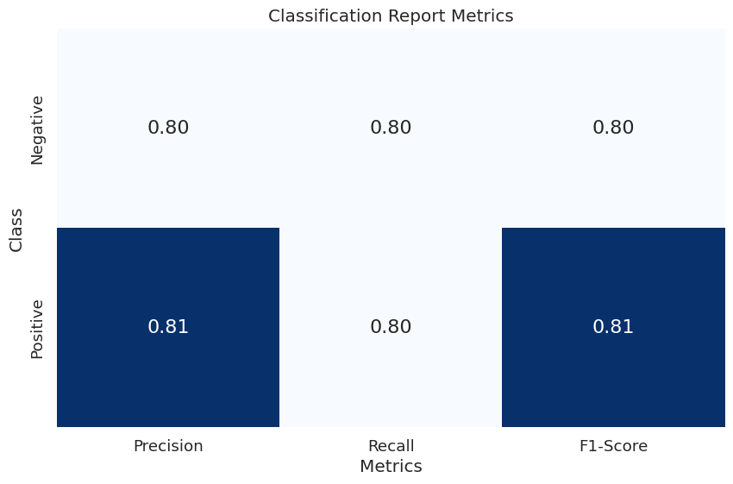
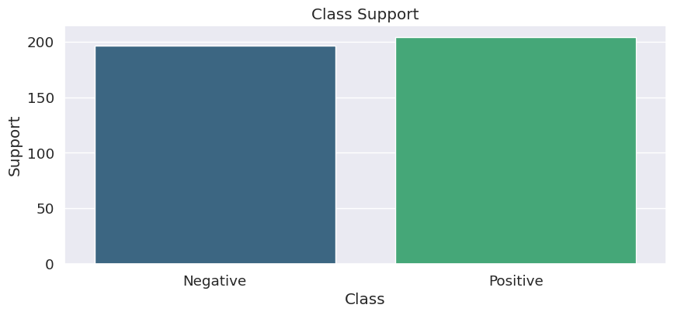
Classification Report :
A heatmap illustrating precision, recall, and F1-score for each class.
A bar plot representing the support for each class.

Slide 10
BERT Model for Sentiment Analysis
BERT (Bidirectional Encoder Representations from Transformers): BERT is a powerful transformer-based language model known for its contextual understanding of text.
Utilizing BERT: Applied BERT's pre-trained model for sentiment analysis on IMDB movie reviews.
Tokenization Process: Employed BERT's tokenizer to break down text into tokens and encode sequences for model input.
Data Formatting: Prepared IMDB review texts for BERT by truncating and padding sequences.
PyTorch Datasets: Converted the formatted data into PyTorch datasets for training and evaluation.
BERT's Strength: Highlighted BERT's capability to capture nuanced context and semantics for accurate sentiment analysis.

Slide 11
BERT Model Training
Architecture Overview: Utilized BERT for Sequence Classification, a pre-trained model fine-tuned for sentiment analysis tasks.
Training Configuration: Defined essential training arguments, including epochs, batch sizes, and learning rate warmup, optimizing model performance.
Trainer Initialization: Initialized the Trainer class from the Transformers library, incorporating the BERT model, training arguments, and datasets.
Training Process: Executed the training phase, wherein the model learned to discern sentiment patterns from the IMDB movie review dataset.
Evaluation: Assessed model accuracy, loss, and other pertinent metrics to gauge performance during and after training.
Impact: Emphasized BERT's ability to yield robust sentiment analysis results through its deep contextual understanding.

Slide 12
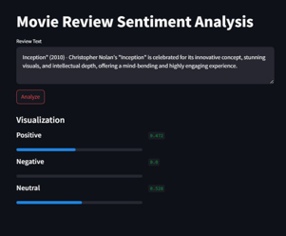
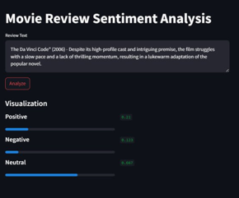
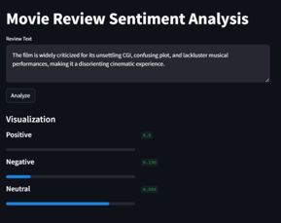
The results of the sentiment analysis determine whether the review expresses a positive or negative sentiment:

Slide 13
Conclusion
Key Findings:
Successful application of various sentiment analysis techniques on IMDB movie reviews.
Traditional ML methods like Naive Bayes showcased moderate accuracy.
NLTK's sentiment analysis demonstrated comparable performance with traditional approaches.
VADER's lexicon-based analysis captured nuanced sentiments effectively.
BERT, a deep learning model, outperformed traditional methods, achieving superior accuracy.
Challenges:
Handling data preprocessing intricacies, including HTML tag removal and lowercase conversion.
Interpreting complex deep learning models like BERT requires substantial computational resources.
Future Prospects:
Potential integration of ensemble methods for improved sentiment prediction.
Exploration of advanced deep learning architectures beyond BERT for enhanced accuracy.
Consideration of fine-tuning techniques to optimize model performance further.

Slide 14
Thank you !

